Slide 1
Site Activity
(Program Metrics)
Training
Chapter 7
Notes:
This presentation covers the importance of capturing and reporting services provided to taxpayers and describes each step of the Activity Reporting process, from the collection of statistics at the site through the input of statistics into the Volunteer Portal.

Slide 2
Content Covered
In this training you will learn…
What Activity Reporting is and why it is important to Tax-Aide
What and when volunteers report information
Site process for collecting and reporting site activity
How to view and report site activity in the new Volunteer Portal
About available site activity reports
AARP Foundation Tax-Aide
Notes:
In this training presentation you will learn …
The definition of activity reporting and why Tax-Aide collects and tracks activity.
Which Information volunteers are asked to collect and report
The site process for collecting site activity
How to view both volunteer and IRS-reported activity in the new Volunteer Portal
How to report volunteer reported activity
About the available site activity reports

Slide 3
Activity Reporting Overview
WHAT: A collection of volunteer generated site-level service and tax return preparation data detailing the services volunteers deliver to AARP Tax-Aide clients
WHY: The information is used:
Primarily to:
Secure funding from sponsors and to meet grant reporting requirements (IRS, AARP, others)
And also to:
Monitor site and program growth, effectiveness and equipment needs
AARP Foundation Tax-Aide
Notes:
Activity reporting is the collection of tax return preparation and other service counts delivered by AARP Tax-Aide volunteers at our sites.
These counts include the preparation of Federal, State and local tax returns along with tax law Questions & Answers that do not result in the preparation of a tax return.
AARP Tax-Aide program sponsors require reports of both the number of returns prepared and the number of taxpayers served.
The reports are used by our current sponsors to justify continued funding and to aid in securing additional funding. The collected data also helps all levels of leadership better manage site and program growth, our effectiveness and future needs.
Some of the Activity Reporting counts are provided by the IRS, while other counts can only be obtained through our volunteers reporting their activity at the site level.

Slide 4
Information Reported by Volunteers
Paper Filed Federal Returns (Current Year)
Paper Filed Federal Returns (Prior Year)
Paper Filed Federal Returns (Amended)
Paper Filed State/Local Only Returns
Questions & Answers Only *
* Q&A counts are critical for determining the number of taxpayers served.
AARP Foundation Tax-Aide
Notes:
Only paper-filed returns must be manually recorded, tabulated and reported by site volunteers.
This includes all paper-filed returns. Some returns that are initially rejected in the e-filing process must necessarily be paper filed such as when a child is claimed as a dependent by two taxpayers and the second taxpayer to file believes they are the one entitled to claim the dependency.
When e-filling State or Local Returns only, they do not need to be manually recorded. The National Office has data to count state-only e-filed returns.
It is not necessary to record e-filed returns as the IRS will provide all the e-filed tax return counts.
In addition to recording and reporting paper-filed returns, site volunteers must also record and report assistance that is provided to taxpayers without the completion of a return (also known as Q & A). In Tax-Aide, Q&A includes responding to questions about tax law, filing procedures, and how to get help with IRS resources and contacts. Q&A may happen other than at the site through phone calls or informal conversations. Taking appointments for tax preparation is not considered Q&A.

Slide 5
Reporting Periods & Due Dates
One Reporting Period per Tax Season
February 1 – September 30
Recommended: Report monthly
Some states may require more frequent reporting
No DC approval/submission required
Review to ensure that data is being collected and reported each year
All Leaders w/Edit and the LC can report activity data
AARP Foundation Tax-Aide
Notes:
Beginning in 2016 there will be only one reporting period for the tax season, February 1 through September 30.
However, it is recommended that sites report month,, Some states may require more frequent reporting
It is no longer required for the DC to submit an approval for the activity submitted. However, good management practice requires that the DC review the saved data to ensure that paper-filed and Q&A activity has been collected and reported each year.
LCs, DCs, ACs can report the data using the new Volunteer Portal. ADSs may assist as necessary.

Slide 6
Collecting and Reporting Process (LC)
Step 1: Collect Data – Daily
Site Activity Log is completed at site by Counselors
Step 2: Tabulate – Weekly
Site Activity Logs are collected and tabulated by the LC/SCO
Excel template can be used to calculate weekly or monthly totals (highly recommended)
template found on OneSupport Help Center
Step 3: Report Data
Site’s totals are entered into the current tax season’s Program Metrics record for each site Program
AARP Foundation Tax-Aide
Notes:
Local Coordinators are responsible for the site activity collection and reporting process.
Displayed is a summary of the process and steps Local Coordinators should use to collect, tabulate and report their sites’ activities. There are three key steps.
Step #1 – Collect Data. The collection of site data must be captured on a real-time, taxpayer-by-taxpayer served basis using the Site Activity Log (or a locally modified version thereof).
Step #2 – Tabulate. It is recommended that the Site Activity Logs be collected daily and tabulated at least weekly. A Site Activity Collection Template is available and can be used to complete the tabulation tasks. The template is an Excel file that is available on the OneSupport Help Center.
Step #3 – Report Data. As required by the State Coordinator or by May 1, the cumulative year-to-date totals for each type of activity are recorded in the Volunteer Portal, Site program’s Program Metrix Record.

Slide 7
Roles for Site Activity
 | ADS | DC | LC | COU
Train and support DC/LC | X
Capture site activity |  |  |  | X
Tabulate data |  |  | X
Report activity data |  |  | X
Review reported data |  | X
Update/correct activity (as requested by sites) | X | X | X
Encourage reporting from all active sites | X | X
AARP Foundation Tax-Aide
Notes:
The ADS plays a key role in ensuring that their districts can accurately report activity.
The ADS should train, as needed, the DCs and LCs on how to use the new Volunteer Portal to view and report site activity data. (Refer LCs and DCs to this training presentation which is on the OneSupport Help Center.
ADSs need to confirm that all sites are correctly coded as active or inactive prior to the start of the tax season.
On occasions ADSs may be asked to assist in updating volunteer reported site activity data.
ADS s should confirm that all their split-state’s active sites are reporting their site activity. Encourage data reporting on the schedules determined by the split-state’s procedures.

Slide 8
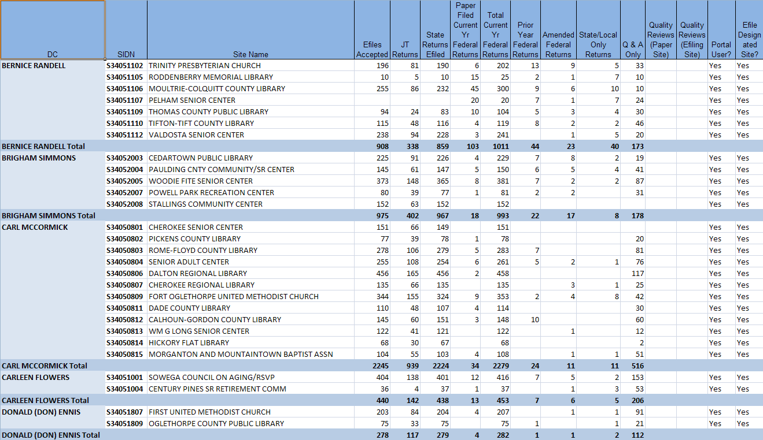
2016 (TY2015) Reports
IRS e-file reports will be uploaded to the Program Metrics record
Flash reports will be made available by the National Office
AARP Foundation Tax-Aide
Notes:
IRS e-File reports will be uploaded to the Program metrics record eliminating the requirement for National Office distribution.
The Tax-Aide National Office will continue distributing monthly Flash Reports as in prior years.
Flash reports summarize data at the district level within split-state.
Information on how this report will be delivered in 2016 is forthcoming.

Slide 9
Site Activity Data Structure
Program - geographical location or site
(example: TA-R01-CT1-D01-S10053138)
Program Metrics –One record per site program per tax season. Used to store IRS and volunteer reported activity.
AARP Foundation Tax-Aide
Notes:
In the new Volunteer Portal every active Site program has one Program Metrics record per tax season
New Program Metrics records are system created prior to the opening of a new tax season.
The Program Metrics record is used to store volunteer reported data and IRS reported data

Slide 10
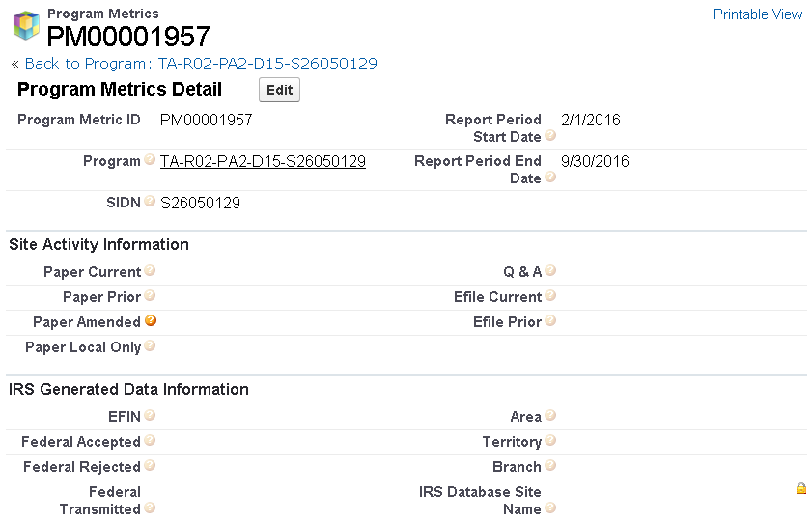
View Site Activity
Notes:
Report by May 1 or more frequently
Always enter cumulative totals
AARP Foundation Tax-Aide
Notes:
This is the Program Metrics record for a site.
The record displays the following information.
The reporting period dates
Fields LCs use to record paper-filed and Q&A counts
There are two optional fields that a volunteer leader can use to manually track current-year and prior-year e-file counts. They might be used by those wishing to track efiles counts at the SIDN level when sites share an EFIN, such as ad hoc sites. Or, some may wish to record their e-file counts and compare local e-file statistics with IRS reported statistics.
IRS weekly reported e-file counts are stored in section 4 by the National office on a weekly basis beginning in late February. All IRS data is reported by EFIN
Now Sophie will demonstrate how to report site activity.

Slide 11
DEMO: Reporting site activity
AARP Foundation Tax-Aide

Slide 12
APPLICABLE ROLES: LC, DC, AC, ADS
SCENARIO:
To ensure all services we offer are properly captured, the cumulative total for different types of service activities need to be entered into the site Program Metrics record. Monthly reporting is recommended, while some states may require more frequent reporting. Please refer to your state's guideline on frequency and also who will be responsible for reporting. Since there is only one reporting period, each time the user should enter the cumulative total. In this demo we will go through the steps to report some Q&A and paper filing activities.

Slide 13
Reporting Site Activity
STEPS:
From the portal homepage, click on the dashboard tab.
Click on any line in the sites column
Once the report is displayed, find and click on the program (e.g.TA-R01-CT1-D01-S10053138) that needs to be updated.
Scroll down to the program metrics section, and click edit next to the current season's Program Metrics record.
In the Site Activity Information section, complete all applicable fields, and click save.
Note: You can hover your cursor over the Help icon for a description of each field.

Slide 14
Support & Reference Materials
For Activity Reporting Support:
Local Coordinators contact your District Coordinator
District Coordinators contact your Administration Specialist
Reference/Training Materials on OneSupport Help Center
Activity Reporting Training (PDF & Narrated Brainshark)
Site Activity Log (Excel and PDF versions)
Site Activity Collection Template (Excel)
Site Activity Log (D19597) Examples (PDF)
Frequently Asked Questions (PDF)
AARP Foundation Tax-Aide
Notes:
That brings us to the close of Activity Reporting Training.
We highly recommend that you review both the Site Activity Log Examples and Frequently Asked Questions documents posted on the OneSupport Help Center in the Portal Support, Activity Reporting section.
The Frequently Asked Questions document will be updated throughout the activity reporting season, based on your feedback and experiences.
For any questions or issues related to Site Activity Reporting, Local Coordinators should contact their District Coordinator and District Coordinators should contact their Administration Specialist. The ADS can contact the National Office, by OneSupport Submit a Request

